Slide 1
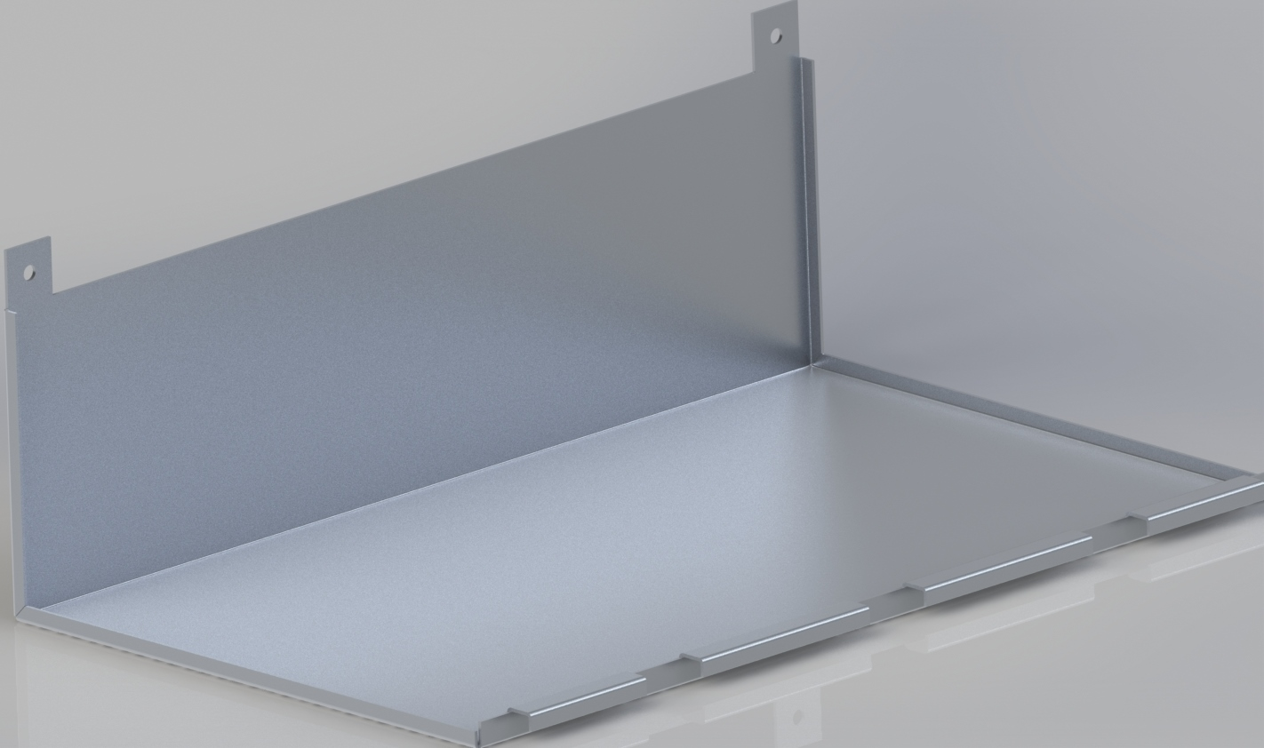

Chassis Upgrades
Tasks
Differential Bar
Chassis panel covers
Battery Clips
Frame Cross members
Camera Platform

Slide 2
Differential Bar
Chassis Upgrades
Battery Clips
Notes:
http://www.franknicol.co.uk/product_images/c/13_0977_61__79287.jpg

Slide 3
Panel Covers
Chassis Upgrades
Design Considerations
Bottom must solid to hold electronics
Must fit under arm assembly
Easily removable

Slide 4
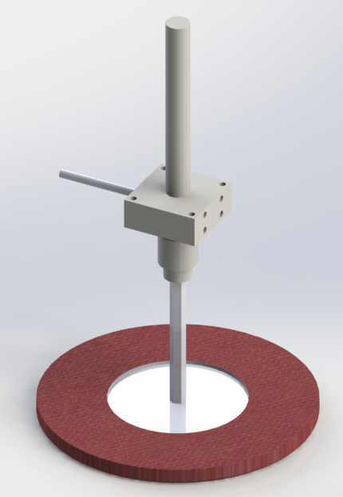
Chassis Upgrade

